Slide 1
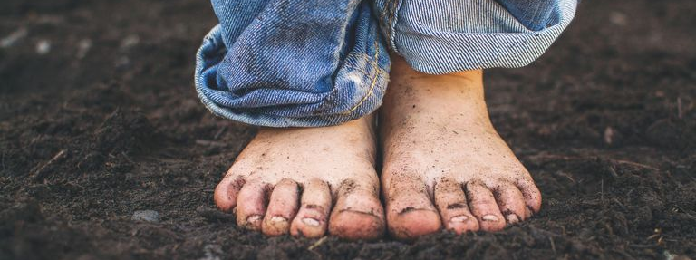


Even Better than the Real Thing?
Dr. Peter Francis, PhD
Barefoot Strong Summit
October 26 & 27th 2019

Slide 2
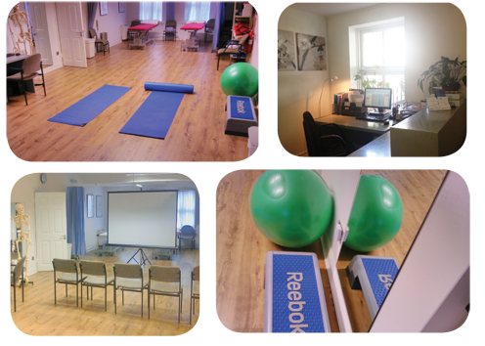
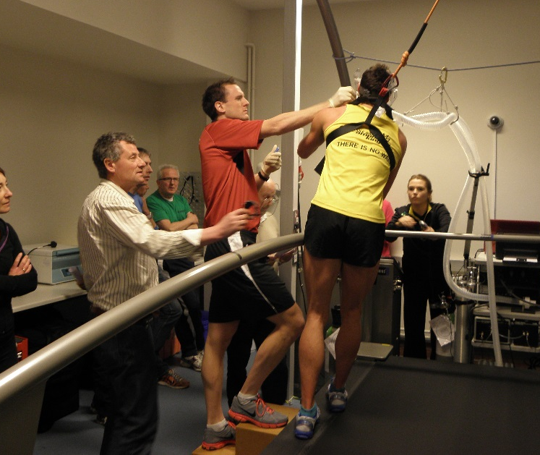

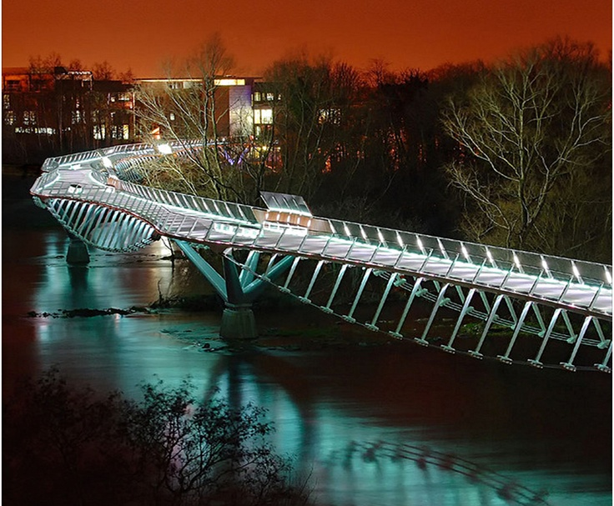
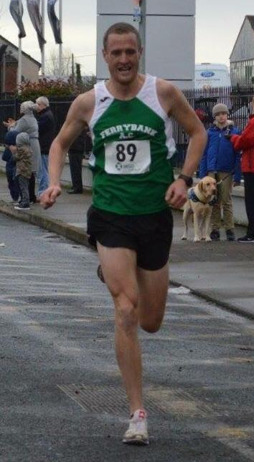
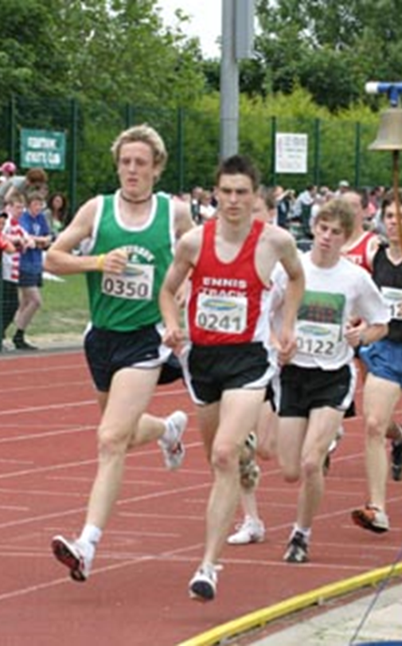
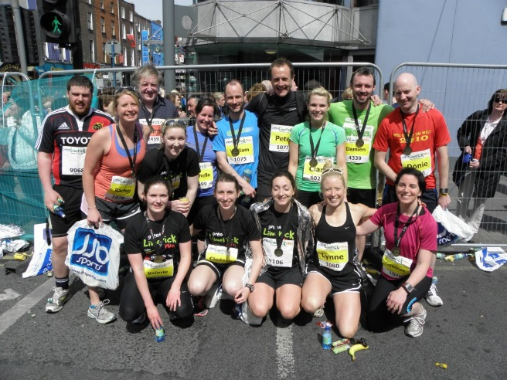
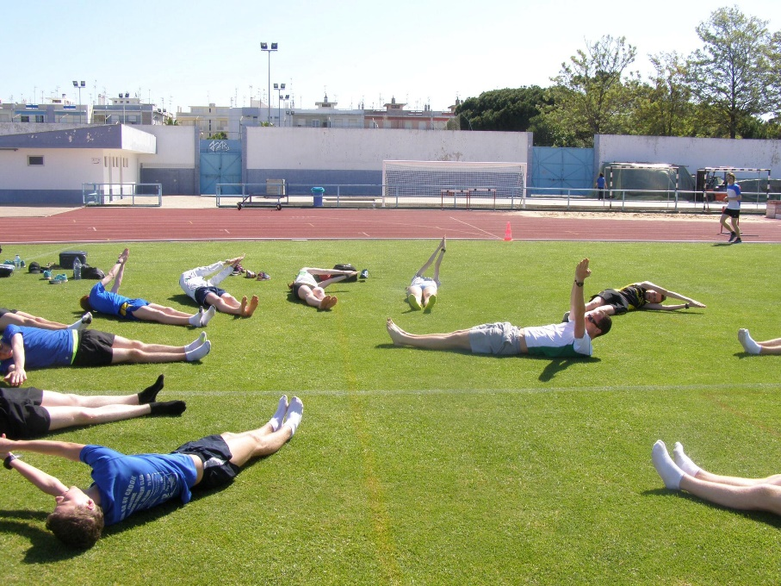
Why me? Why Barefoot?

Slide 3
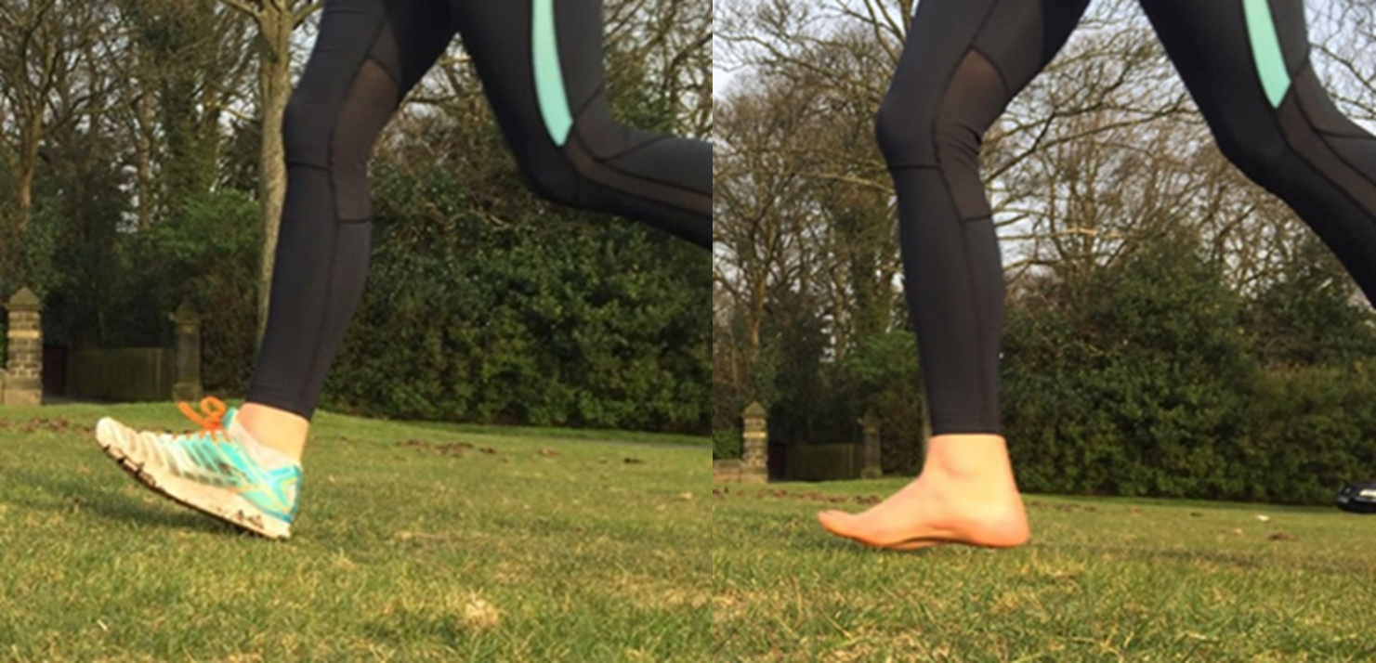
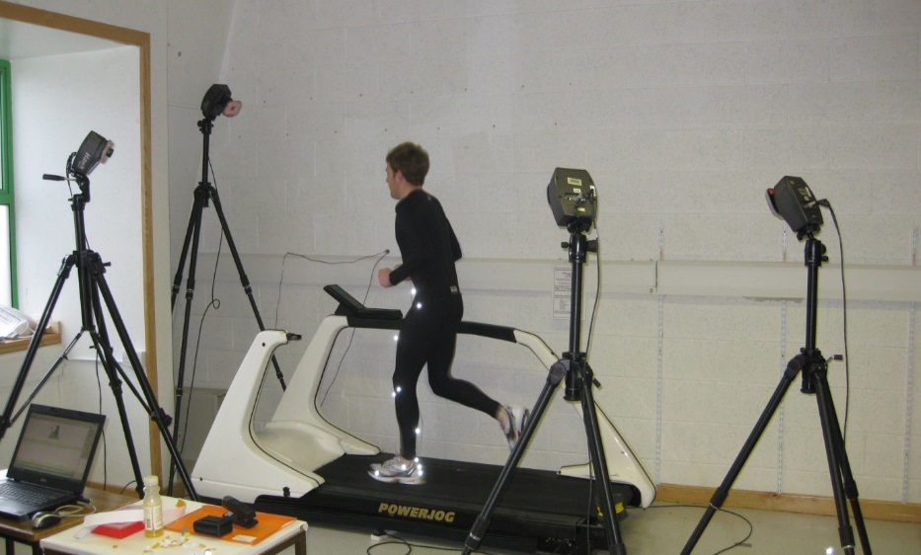
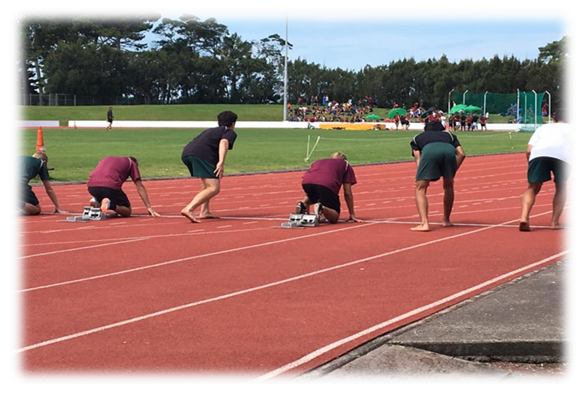
Why me? Why Barefoot?
Francis et al. (2016) JSSM, 15 (3), 417
Francis et al. (2017) IJAT, 22(5), 26
Francis et al. (2018) JFAR, 11(1), 42

Slide 4
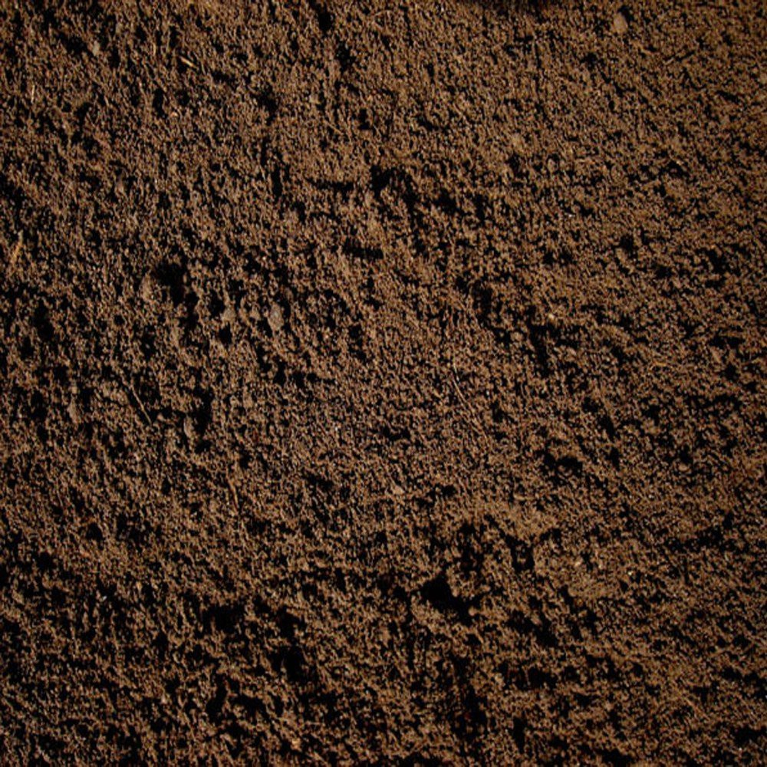
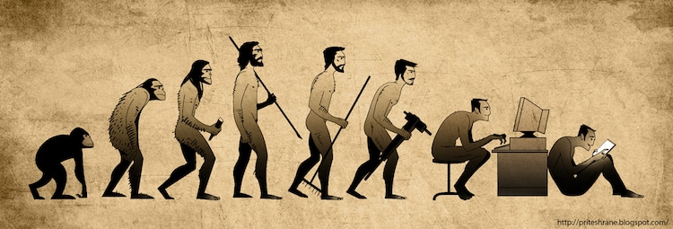
TODAY……
What is the real thing?
What is the impact of footwear on the real thing?
What does the data say?
What happens when we go back to being barefoot / minimalist?

Slide 5
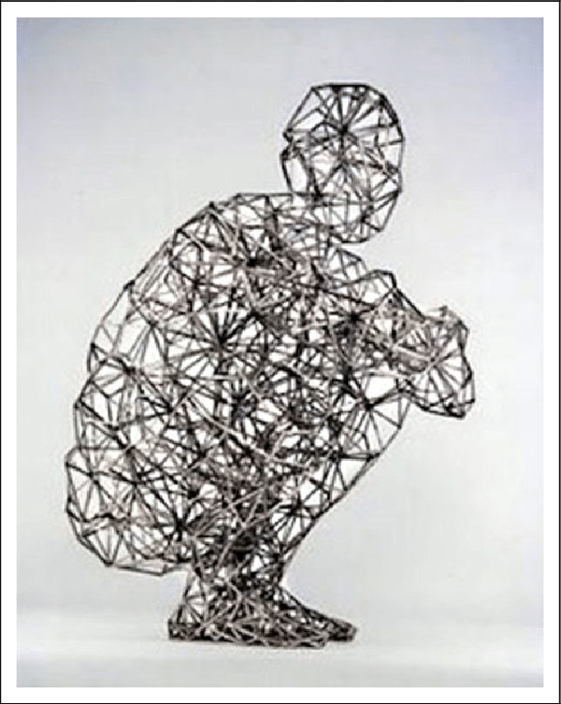
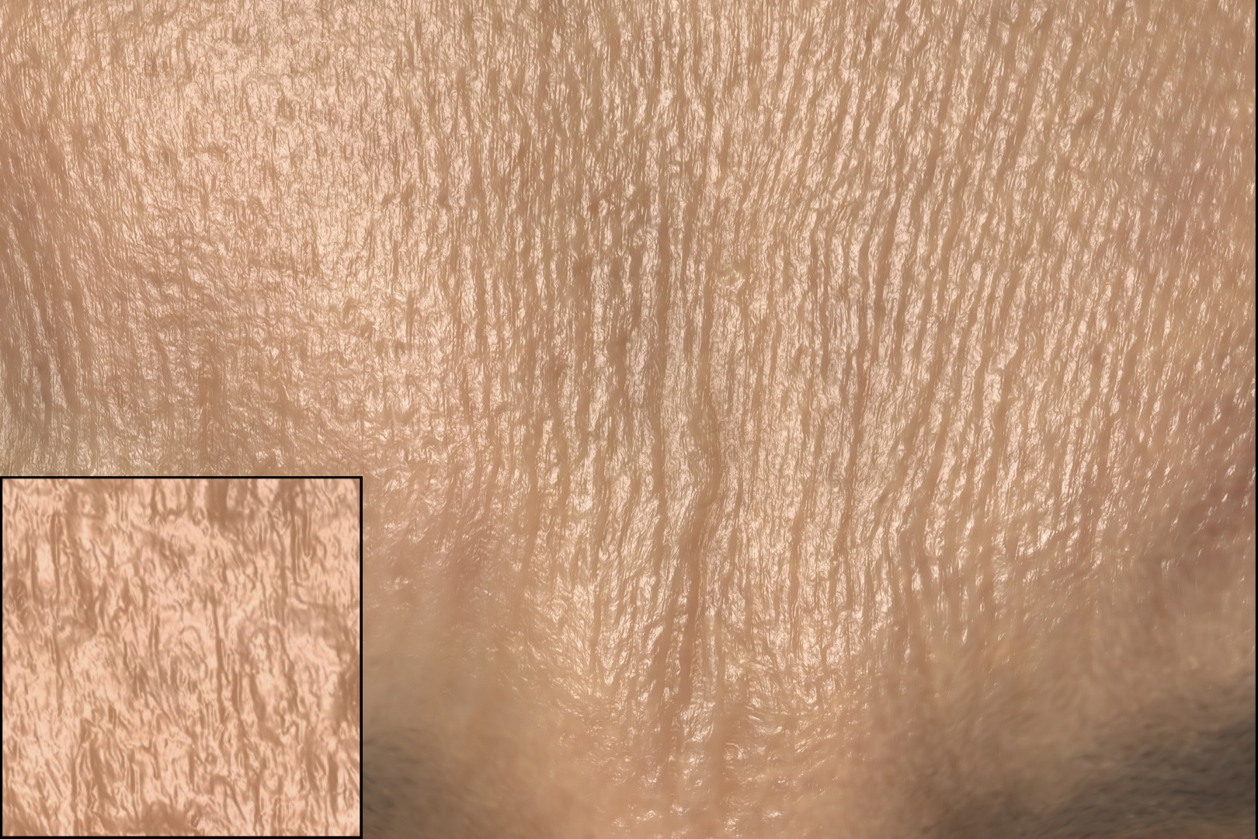

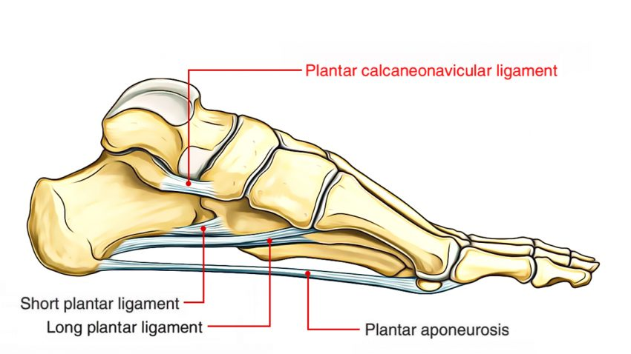
The Real Thing: Biotensegrity
van der Krogt et al. (1985) J Appl Physiol, 107 (3)
Ker et al. (1987) Nature, 147-149
Kiely (2016), Front Psychol, 7:262

Slide 6
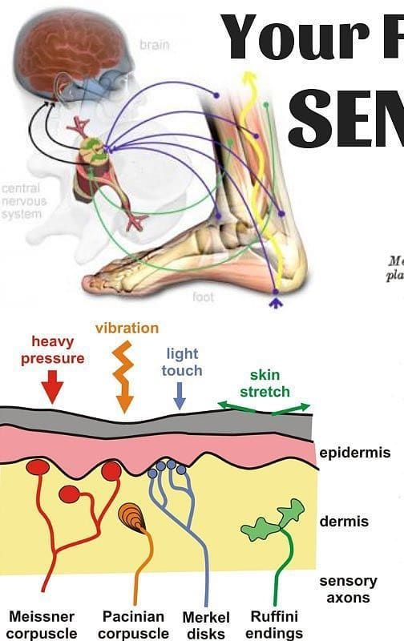
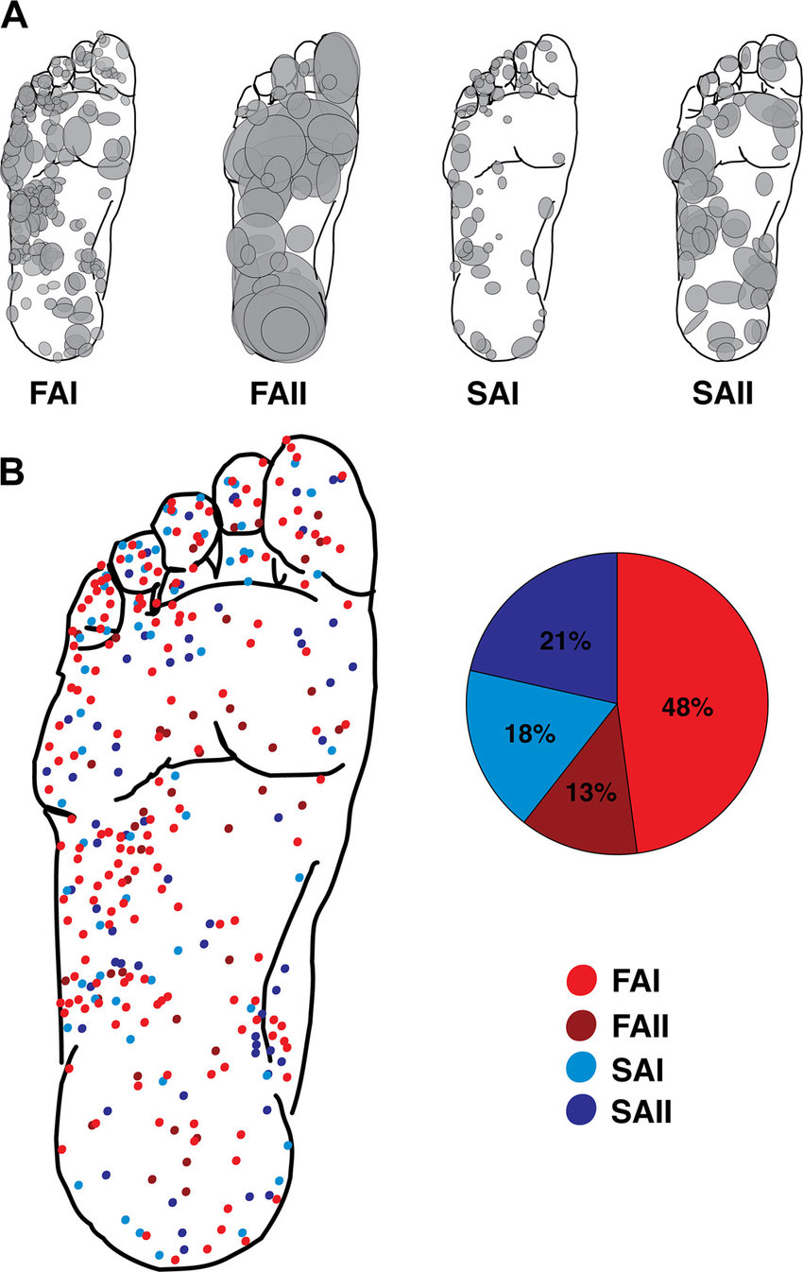
The Real Thing: The Nervous System
Strzalkowski et al. (2018) J Neurophysiol, 1233 - 1246

Slide 7
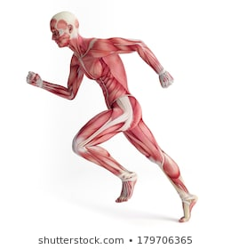
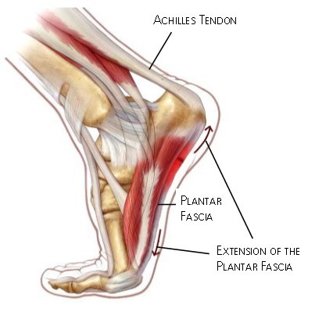
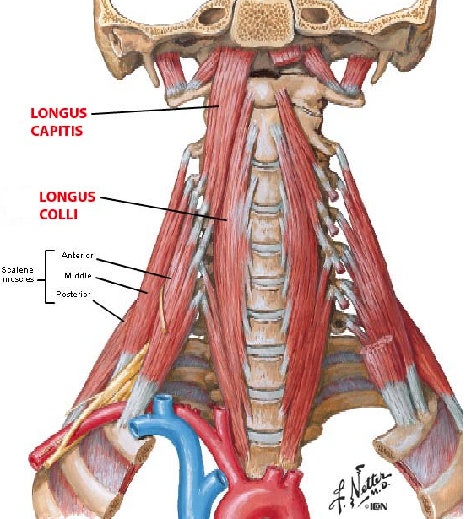
The Real Thing: Muscles in Movement
O’Sullivan (2000) Man Ther, 5 (1)
Falla et al. (2003) Exp Brain Res, 157(1)
Mc Keon et al. (2015) Br J Sports Med, 49(5)

Slide 8
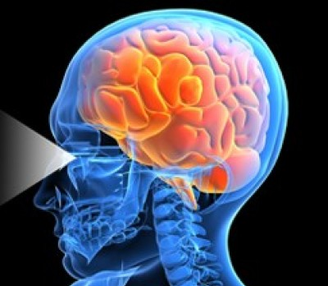
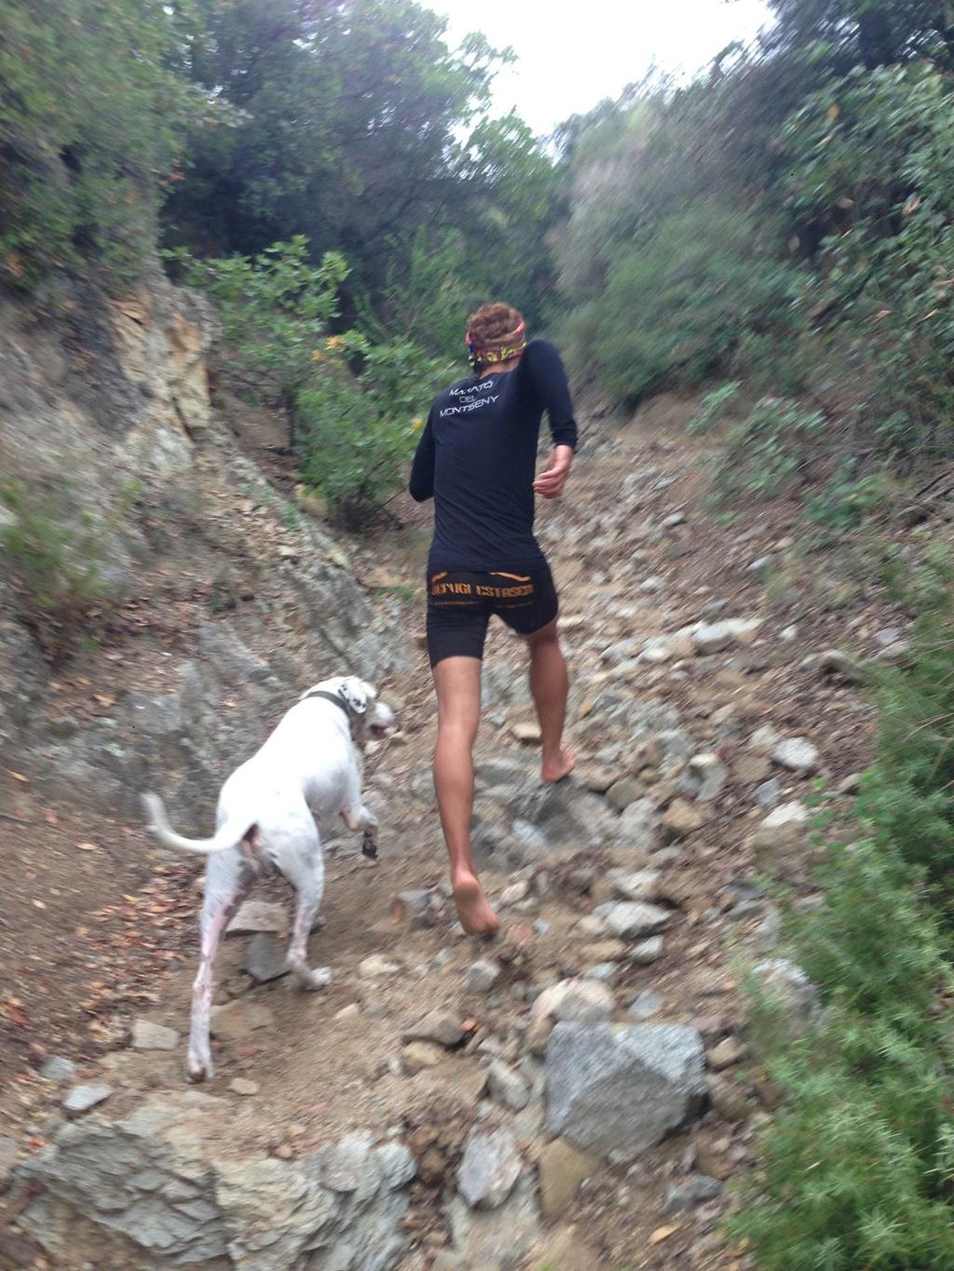
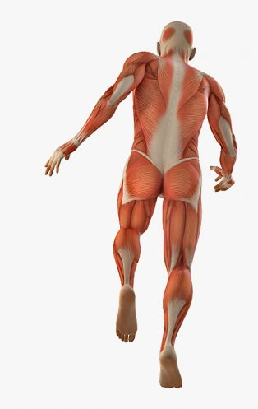
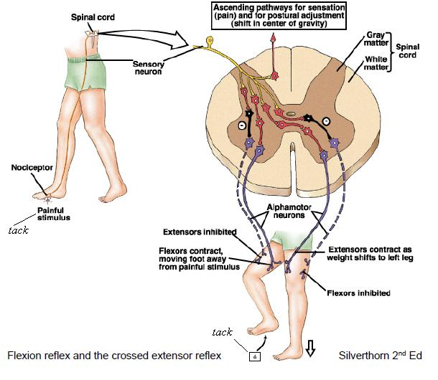
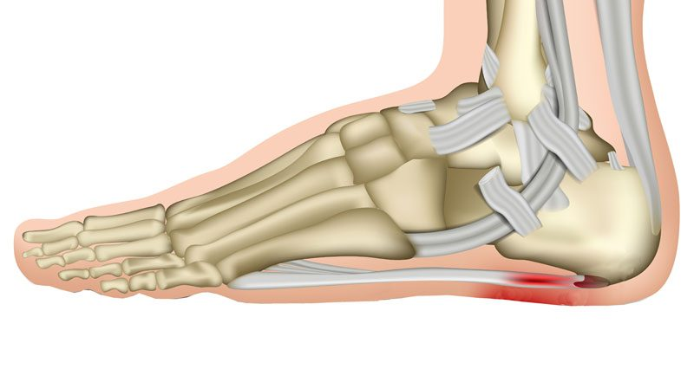
The Real Thing…
Daley et al. (2007) J Exp Biol., 383 - 394

Slide 9
TODAY……
What is the real thing?
What is the impact of footwear on the real thing?
What does the data say?
What happens when we go back to being barefoot / minimalist?

Slide 10
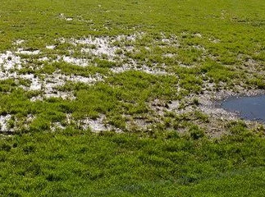
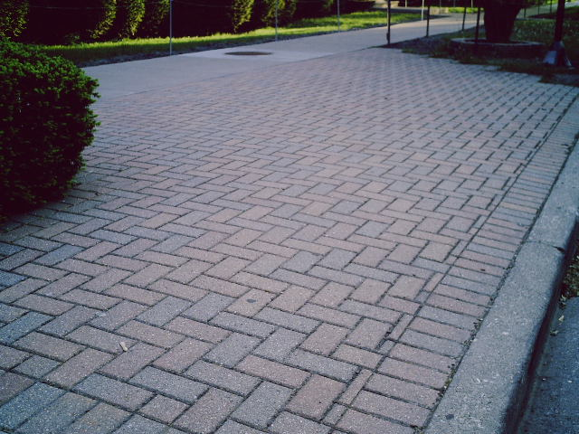
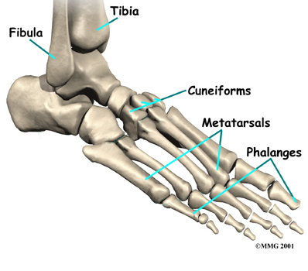
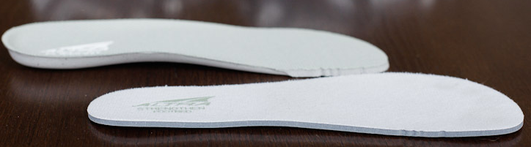
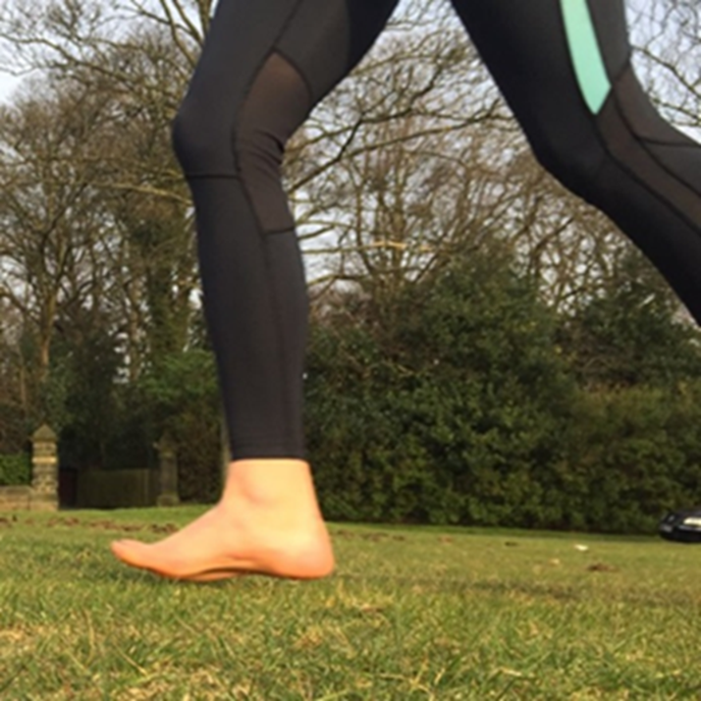
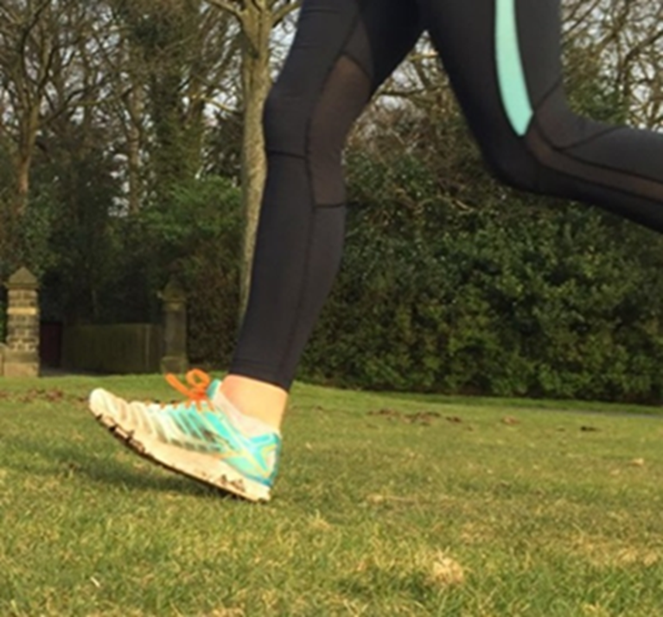
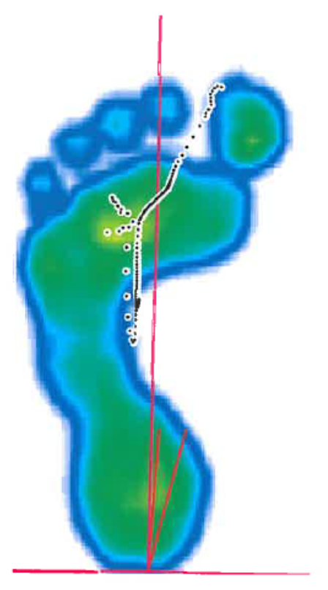
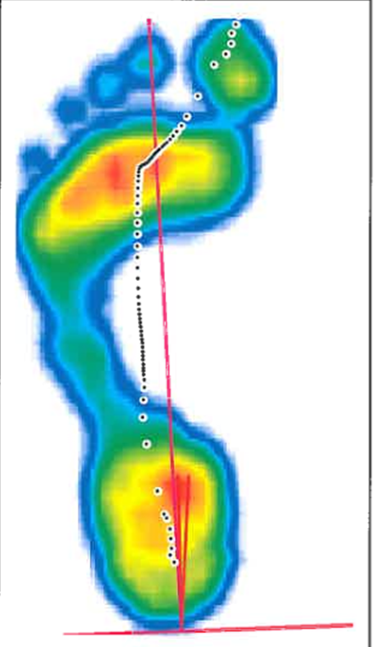
Before we begin…spot the difference!

Slide 11
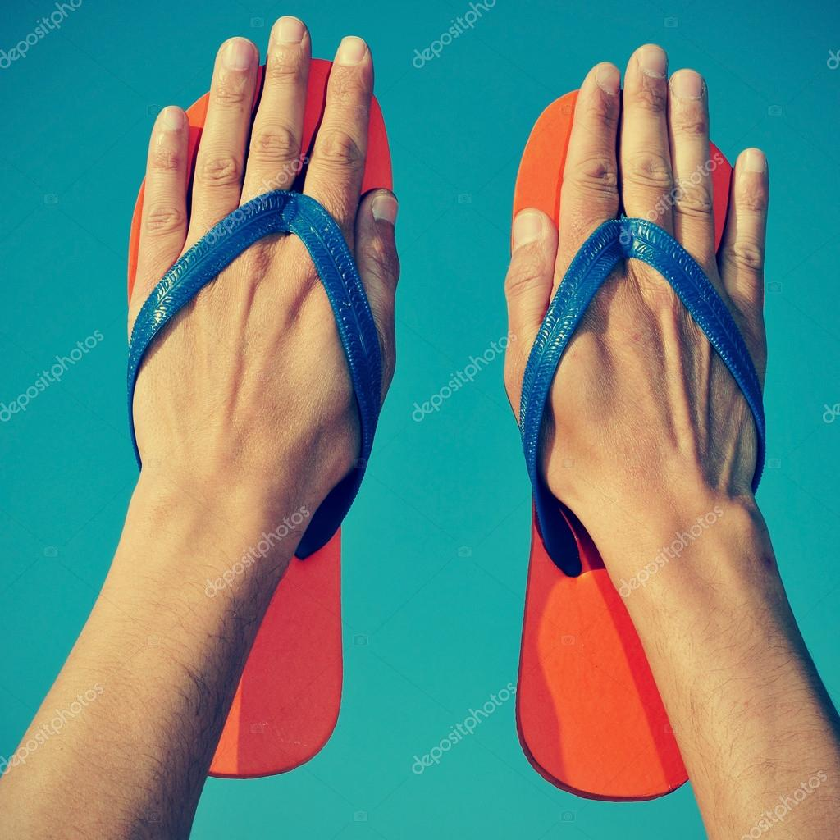
Altered Biotensegrity
Smith et al. (2019), JBBM, (95) 240 - 248

Slide 12
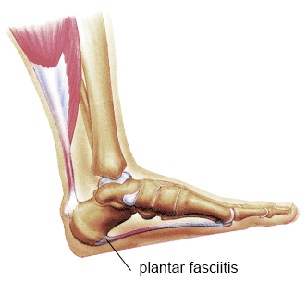
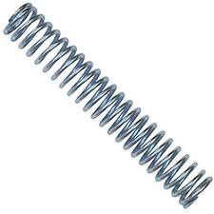

Altered Biotensegrity…Running
Alexander (1991) J Exp Biol, 55 – 69
Perl (2012) MSSE, (44) 7

Slide 13
Altered Sensory Input
Stolwijk et al. (2013), PLoS One, (8) 2

Slide 14
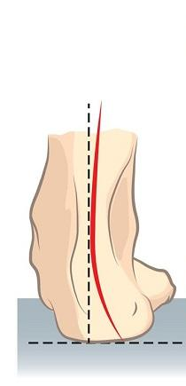
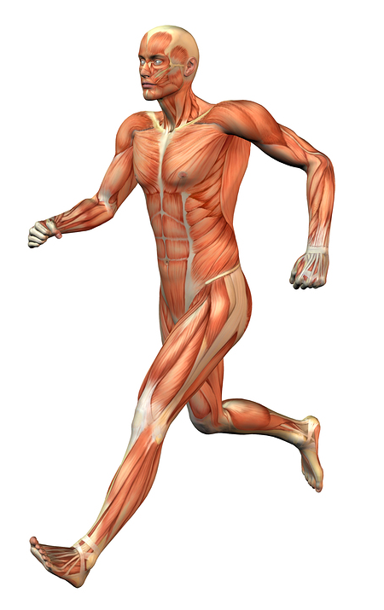
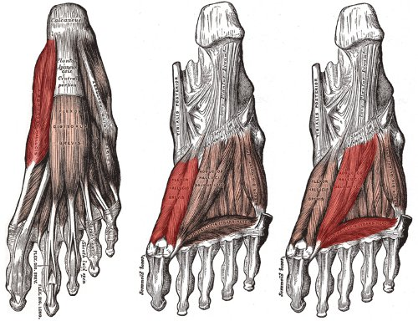
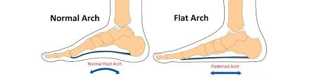
Altered Muscle Output…
Rao and Joseph (1992) JBJS, 74 (4)
Echarri and Forriol (2003) JPO, 12 (2)
Headlee et al. (2008) J. Elect Kin, 18 (3)

Slide 15
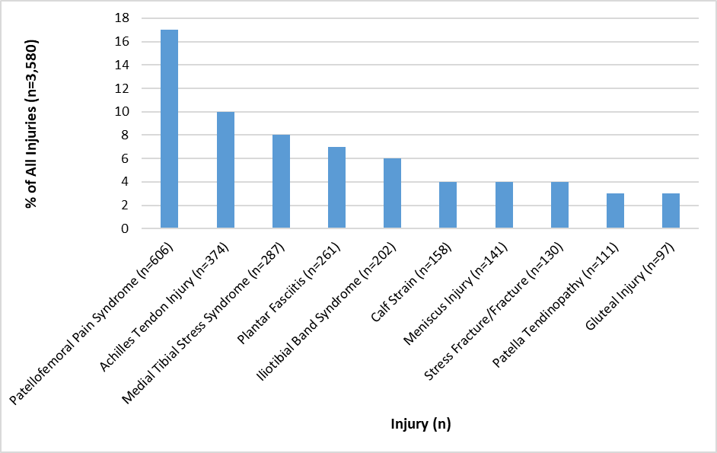

Slide 16
TODAY……
What is the real thing?
What is the impact of footwear on the real thing?
What does the data say?
What happens when we go back to being barefoot / minimalist?

Slide 17
Walking is mans best medicine…
Holowka et al. (2019) Nature, 1

Slide 18
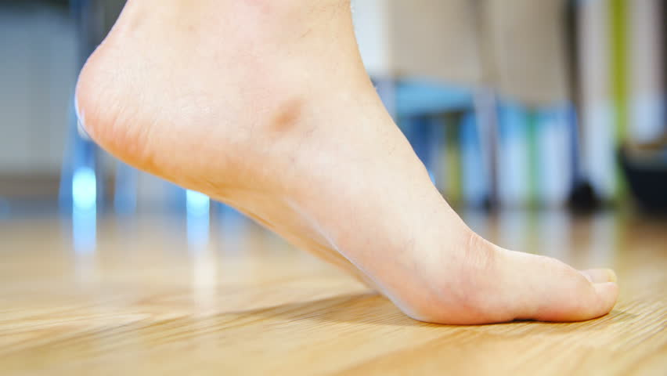
% of Rearfoot Strike (n=35 runners)
Cushioned: 94.3 %
Cushioned minimalist: 88.6 %
Minimalist: 62.9 %
Similar findings in 36 children aged 6 – 9-y
Hollander et al. (2014) Gait & Posture, 40 (3)
Barefoot: 58.6%
Hollander et al. (2015) PLoS One, 10 (5)

Slide 19
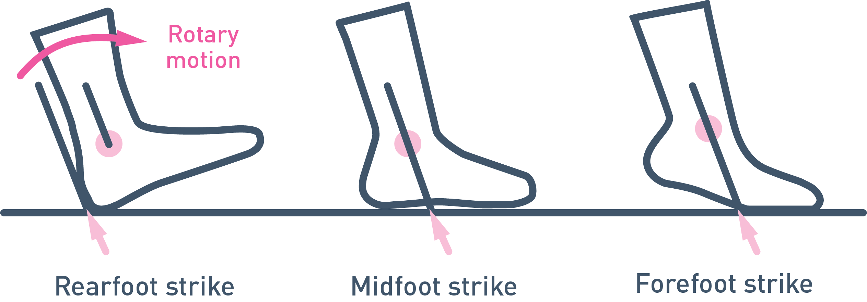
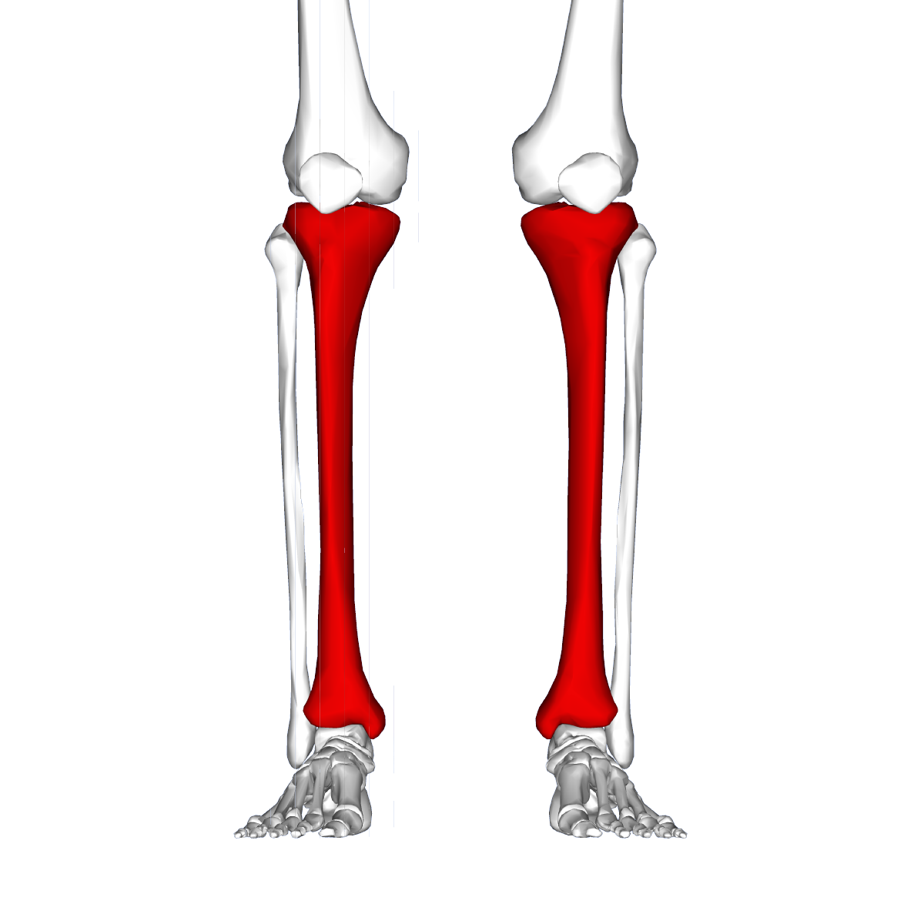
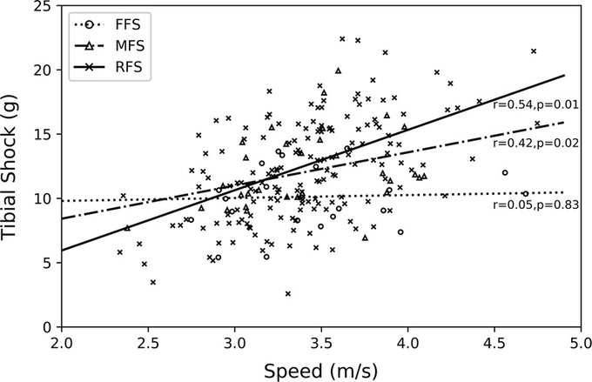
Rearfoot Strike. So what?
98% of World Championship Marathoners Rearfoot Strike
Hanley et al. (2019) JOB, May 22
Ruder et al. (2019), MSSE, 51 (10)

Slide 20
TODAY……
What is the real thing?
What is the impact of footwear on the real thing?
What does the data say?
What happens when we go back to being barefoot / minimalist?

Slide 21
Being Barefoot
45.3% habitually barefoot.
Francis et al. (2018) JFAR, 11(1), 42
Barefoot Half of the Time or More

Slide 22
Walking minimalist vs. strength training…
Control
Foot Strength Prog
Minimalist Shoe Walking
Olsen et al. (2016) MSSE, 48 (5)

Slide 23
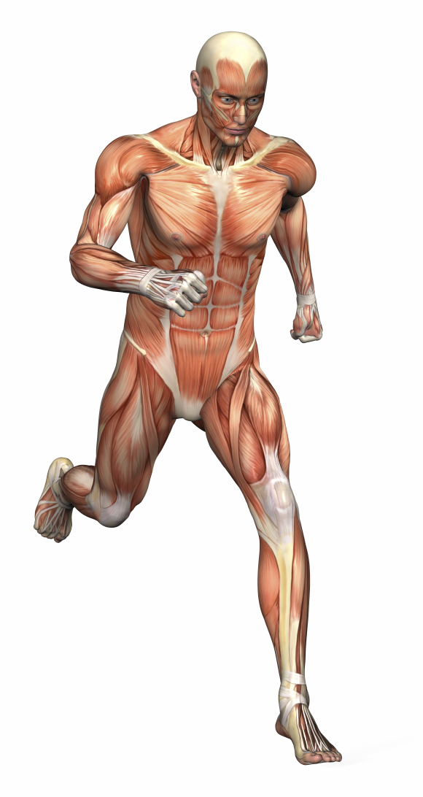
Tam et al. (2016) AJSM, 44 (3)

Slide 24
Biomechanical changes shod vs. barefoot
Francis et al. (2016) JSSM, 15(3)

Slide 25
What happens to injury?
Knee Injury = 12 (s) vs. 5 (b)
Calf-Achilles = 5 (s) vs. 14 (b)
Altman and Davis (2016) Br J Sports Med, 50 (8)

Slide 26
The Challenge of Urban Environments
Altman and Davis (2016) Br J Sports Med, 50 (8)

Slide 27
TODAY……
What is the real thing?
What is the impact of footwear on the real thing?
What does the data say?
What happens when we go back to being barefoot / minimalist?

Slide 28
Conclusion……
The body uses a complex interplay of systems to moderate impact.
These systems are impaired when using modern footwear.
Minimalist shoes appear to allow us to make use of these natural systems whilst avoiding cuts and bruises.
Transition to minimalist activities should be progressed slowly as with any new exercise intervention.

Slide 29
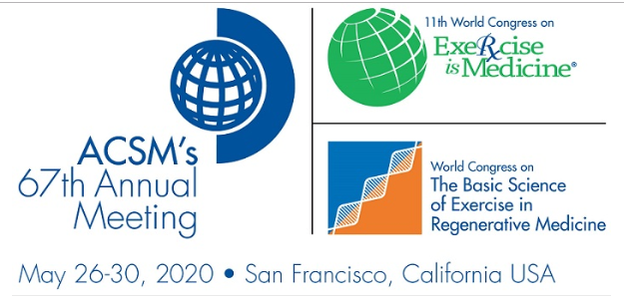


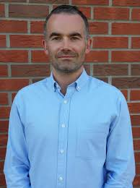

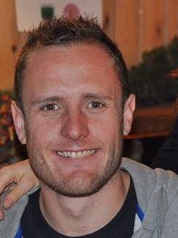

Come to San Francisco…2020
Running from Injury:
Integrating Connective Tissue, Sensory and Motor Systems
1) Structural deformation and sensory stimulation of the foot (Prof. Leah Bent, Guelph)
2) Muscles in movement (Prof. Jamie Mc Phee, Manchester)
3) Optimizing kinematics to minimize injury (Prof. Irene Davis, Harvard)
4) An integrative approach to injury (Dr. Peter Francis, Carlow)

